Slide 1
ANALOG TV –
TRANSMISSION AND BROADCAST

Slide 2
Topics
Basic principle of Television
Analog TV transmission
    TV Transmitter Block Diagram
    AM, FM and PM
    Electromagnetic spectrum
TV Interfaces
    Composite
    Component
    S-Video
    Coaxial RF
    Computer interfaces
    SCART
TV Broadcast

Slide 3
Basic principle of Television
Television
  Electronic system for transmission and reception of still or moving images and sound by means of electrical signals, especially by means of electromagnetic radiation
Persistence of vision
  Divide a moving scene into a sequence of still pictures and show the still images in rapid succession, the brain will reassemble the still images into a single, moving scene
Interlacing
  An analog TV set can display 525 horizontal lines of resolution every thirtieth of a second. In reality, however, an analog TV displays half of those lines in a sixtieth of a second, and then displays the other half in the next sixtieth, so the whole frame is updated every thirtieth of a second
Frame rate
  Minimum required rate: 25 to 30 frames/sec

Slide 4
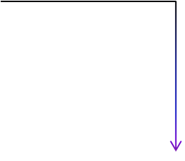




Block diagram of TV Transmitter
Crystal Oscillator
RF Amplifier
Power Amplifier
Transmitting antenna
Scanning & Synchronizing circuits
Combining network
TV Camera
Video Amplifier
AM Amplifier
Light
Microphone
Audio Amplifier
FM Amplifier
FM Sound Transmitter

Slide 5
Basic principle of Television
A video camera takes a picture of a scene. It does this at a frame rate of 30 frames per Sec.
The camera rasterizes the scene. That is, the camera turns the picture into rows of individual dots called pixels. Each pixel is assigned a color and intensity
The rows of pixels are combined with synchronization signals, called horizontal sync and vertical sync signals, so that the electronics inside a TV set will know how to display the rows of pixels
This final signal, containing the color and intensity of each pixel in a set of rows, along with horizontal and vertical sync signals, is called a composite video signal
Sound is completely separate
When a composite video signal is broadcast over the airwaves by a TV station, it happens on a specific frequency
The composite video signal is transmitted as an AM signal and the sound as an FM signal on these channels

Slide 6
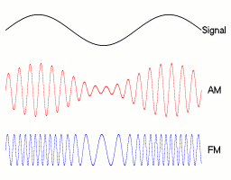
AM and FM
Amplitude Modulation (AM) is a method of transmitting information using radio waves in which the amplitude of the carrier wave is varied in accordance with the amplitude of the input signal
Frequency Modulation (FM) a method of transmitting information by varying the frequency of the carrier wave in accordance with the amplitude of the input signal

Slide 7
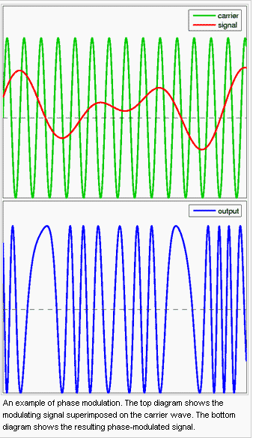
Phase Modulation (PM)
PM is a form of modulation that represents information as variations in the instantaneous phase of a carrier wave
Requires complex receiving hardware
Phase Shift Keying (PSK) is the digital form of Phase Modulation and is used in Digital TV

Slide 8
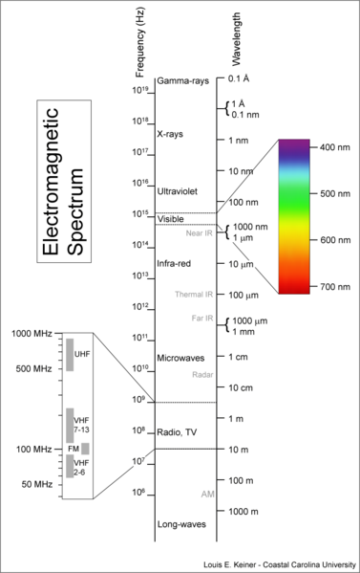
Electromagnetic spectrum
UHF and VHF are most commonly used for TV transmission and reception
Ultra high frequency (UHF)
  300 MHz to 3 GHz
Very high frequency (VHF)
  30 MHz to 300 MHz

Slide 9
TV Interfaces
  Analog video interfaces
      Composite video signal (CVBS)
      Component video
      S-video (Y/C)
      Coaxial (RF)
  These three interfaces differ in their level of information combination (or Encoding)
  More encoding typically degrades the quality but allows the signal to be carried on fewer wires
  Component has least amount of encoding and Composite the most

Slide 10

Composite Video Interface (CVBS)
Composite signals are the most commonly used analog video interface.
Composite Video is also referred as CVBS (Color, Video, Blanking, Sync ) OR Composite Video Baseband Signal
Composite uses one wire pair. Each wire pair consists of a Signal and a Ground
It combines the brightness information (Luma), color information (Chroma) and the Synchronizing (Horizontal and Vertical Synch) signals on just one cable i.e. Signal
Composite video connector - Yellow female RCA jack
Note: RCA stands for Radio Corporation of America, who introduced the design of this connector

Slide 11
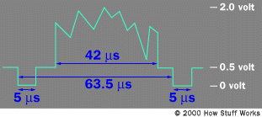
Composite Video Interface
Horizontal retrace signal is 5 microsecond @ 0 volt
The actual signal for the line is a varying wave between 0.5 volts and 2.0 volts
  0.5 volts for black
  2 volts for white
This signal drives the intensity circuit for the electron beam
A vertical-retrace pulse is similar to a horizontal-retrace pulse but is 400 to 500 microseconds long

Slide 12

Component video Interface
Component signal interface are the highest performance, because they have the least encoding
They always utilize three pairs of wires that are typically in either a Luma (Y) and two-color -difference-signals (B-Y, R-Y) or RGB formats
The Y signal contains the brightness (Luma) and synchronizing information, and the color-difference signals contain the red (R) minus the Y signal and the blue (B) minus the Y signal

Slide 13


S-video Interface (Y/C Signal)
S-video stands for “Separate Video” is also refer as "Y/C Signal“
The Y/C signal is a video signal with less encoding. Brightness (Luma), which is
the Y signal, and the color (chroma) ,the C signal, are carried on two separate sets
of wires
The connector is a mini-DIN type

Slide 14
S-Video Interface
It is one of the higher quality ways to transmit the television signal from a peripheral device (DVD player, PlayStation 2, etc) to a television
The way S-Video works is that it basically separates the color information (Chrominance) from the brightness (Luminance)
By doing this, it reduces things like color bleeding and dot crawl and greatly increases the general clarity and sharpness of the picture
This is the reason that televisions are designed to display separate Luminance (Y) and Chrominance (C) signals

Slide 15
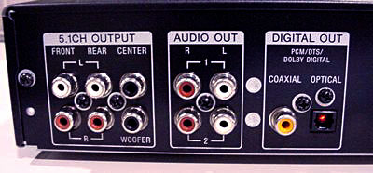
Coaxial RF
RF connectors are widely used in many areas of electronics, covering frequencies from DC up to many GHz.
They are an essential part of many electronics equipment, enabling screened connections to be made to the quality required
RF coaxial cable consists of a central pin for the inner of the coax cable, and then an outer connection around the inner for the outer conductor on the cable
In order that the maximum power transfer takes place from the source to the load, the characteristic impedances (50 ohms or 75 ohms) of both should match
BNC, N-type and UHF (S)239 / PL259) connectors are possibly the most widely used types of connector
DVD player with coaxial digital output

Slide 16
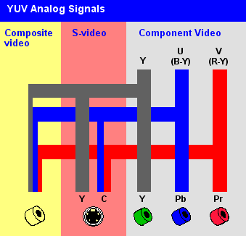
Composite, Component & S-video comparison
It is a composite of three source signals called Y, U and V (together referred to as YUV)
Y represents the brightness or luminance of the picture and includes synchronizing pulses, so that by itself it could be displayed as a monochrome picture
U and V between them carry the color information. They are first mixed with two orthogonal phases of a color carrier signal to form a signal called the chrominance. Y and UV are then added together
Since Y is a baseband signal and UV has been mixed with a carrier, this addition is equivalent to frequency-division multiplexing

Slide 17
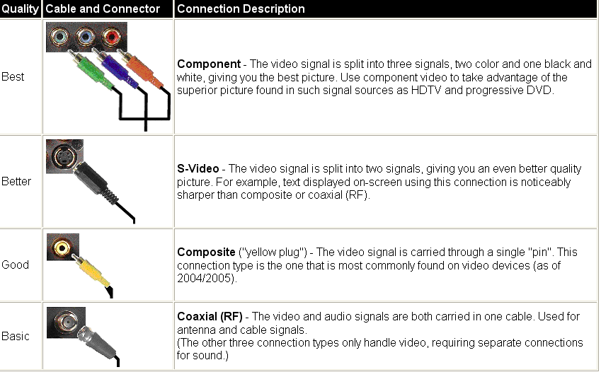

Composite, Component & S-video comparison
Audio input
Stereo Analog Audio connections use red and White color coded "RCA" connections. These support mono or stereo analog

Slide 18
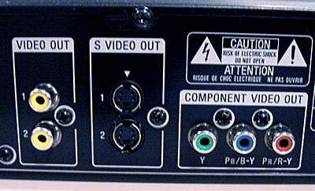
Composite, Component & S-video on DVD player
DVD Player video outputs from left to right: Composite video, S-Video, Component Video

Slide 19
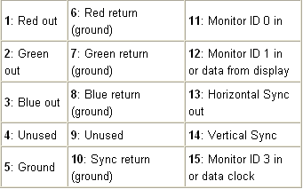
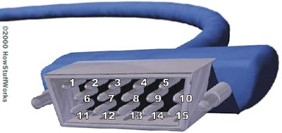
Computer Signal interface
All computer interfaces utilize RGB format signals
Picture information is carried separately by the three base components of red, green, and blue.
Synchronizing information is typically carried as separate horizontal (H) and vertical (V) signals.
The five signals, R, G, B, H, and V, are carried on one cable consisting of a shielded bundle of wires
The connector is almost always a 15-pin D-type connector
Sometimes the H and V sync information is merged with one of the RGB signals, typically the green component, but this is becoming less common. This is referred to as "sync on green"
In rarer cases, the sync information is on the red or the blue signal.
Note: Dsub cable, Sub 15 cable, Analog PC cable, VGA cable are the same

Slide 20
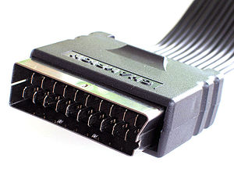
SCART
SCART is a French-originated standard
It is widely used in Europe
It stands for ‘Syndicat des Constructeurs d'Appareils Radiorécepteurs et Téléviseurs’
It has 21-pin connector for connecting audio-visual (AV) equipment together
The signals carried by SCART include both composite and RGB, video, stereo, audio input/output and digital signalling
SCART connector

Slide 21
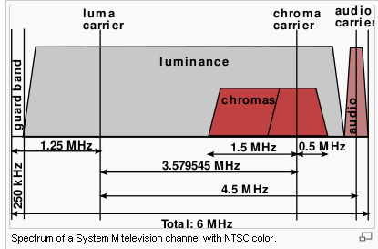
TV Broadcast
A guard band, which does not carry any signals, occupies the lowest 250 kHz of the channel to avoid interference between the video signal of one channel and the audio signals of the next channel down
The actual video signal, which is amplitude-modulated, is transmitted between 500 kHz and 5.45 MHz above the lower bound of the channel.
Video carrier is 1.25 MHz above the lower bound of the channel
Video carrier generates two sidebands, one above the carrier and one below. The sidebands are each 4.2 MHz wide. The entire upper sideband is transmitted, but only 750 kHz of the lower sideband, known as a vestigial sideband, is transmitted.
The color subcarrier is 3.579545 MHz above the video carrier, and is quadrature amplitude-modulated with suppressed carrier.
The highest 25 kHz of each channel contains the audio signal, which is frequency-modulated
The main audio carrier is 4.5 MHz above the video carrier

Slide 22


